Slide 1
SIGMA RTL DESIGN
Eric Qin
Synergy Lab @ Georgia Tech

Slide 2
Verilog Codebase
VERILOG MODEL (VMOD)
TOP MODULE
flexdpe.v - top level module of one flex-dpe
DISTRIBUTION
xbar.v - xbar distribution (pick xbar or benes)
benes.v - benes distribution (pick xbar or benes)
MULTIPLIER
mult_gen.v - generate N multipliers switches
mult_switch.v - multiplier with buffers
bfp16_mult.v - simple BFP16 multiplier
FORWARDING ADDER NETWORK
fan_network.v - pipelined fan network top module
fan_ctrl.v - fan network routing / mux select controller
adder_switch.v - regular fan adder switch (2 outputs)
edge_adder_switch.v - edge fan adder switch ( 1 output)
reduction_mux.v - mux selecting correct inputs to adders
bfp32_adder.v - simple FP32 adder
TESTBENCH MODEL
TOP TESTBENCH
tb_sigma_gen.sv
MODULE TESTBENCH
tb_add.sv
tb_mult.sv
tb_benes.sv
Files highlighted in light green are generated with Python scripts.

Slide 3
Sample Test Case (32 values wide)
INPUT DATA BUS Cyc 1: 32 values of 0x3F80 (= d1) Cyc 2: 32 values of 0x3F80 (= d1) Cyc 3: 16 values of 0x0000 (= d0) and 16 values of 0x3F80 (= d1) Cyc 4: 16 values of 0x0000 (= d0) and 16 values of 0x3F80 (= d1) Cyc 5: 16 values of 0x0000 (= d0) and 16 values of 0x3FC0 (= d1.5) Cyc 6: 16 values of 0x0000 (= d0) and 16 values of 0x4000 (= d2) | DISTRIBUTION DEST BUS Cyc 1: unicast - 1-to-1 mapping Cyc 2: multicast Cyc 3: multicast Cyc 4: multicast Cyc 5: multicast Cyc 6: multicast
VN (PSUM) SEPARATOR Cyc 1: NA (since it is stationary) Cyc 2: One large VN Cyc 3: Two VNs split equally Cyc 4: Two 1-psum VNs at the side, and 10 3-psums VNs in the middle Cyc 5: Two VNs split equally Cyc 6: Two VNs split equally | STATIONARY BIT Cyc 1: 1’b1 Cyc 2: 1’b0 Cyc 3: 1’b0 Cyc 4: 1’b0 Cyc 5: 1’b0 Cyc 6: 1’b0

Slide 4
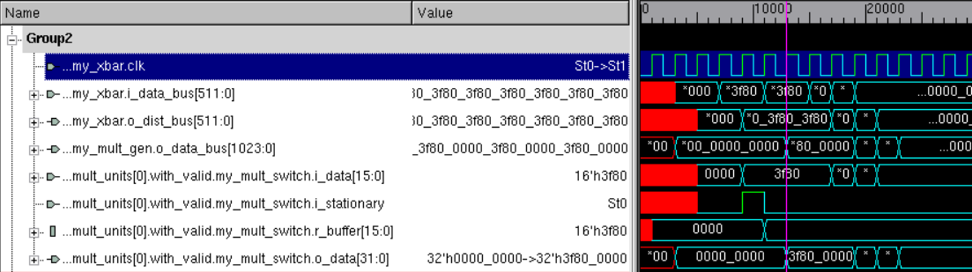
Distributing the Data (with XBar) and Multiplication
Simulation Notes: (32 PEs, BFP16 Multiply, FP32 Accumulation)
my_xbar.i_data_bus[511:0] → input data bus to the distribution network
Data coming from global buffer
my_xbar.o_dist_bus[511:0] → output data bus from the distribution network
One cycle non-blocking distribution
my_mult_gen.i_data_bus[511:0] → output of xbar to the input of all multipliers
my_mult_switch.i_stationary → determine if input goes to the stationary buffer or not
my_mult_switch.r_buffer[15:0] → buffer to hold the stationary elements
my_mult_gen.o_data_bus[1023:0] → output data bus after all multiplications are complete
outputs are the product of the stationary and streaming data
the output width is 2X greater than the input width because of data format change

Slide 5
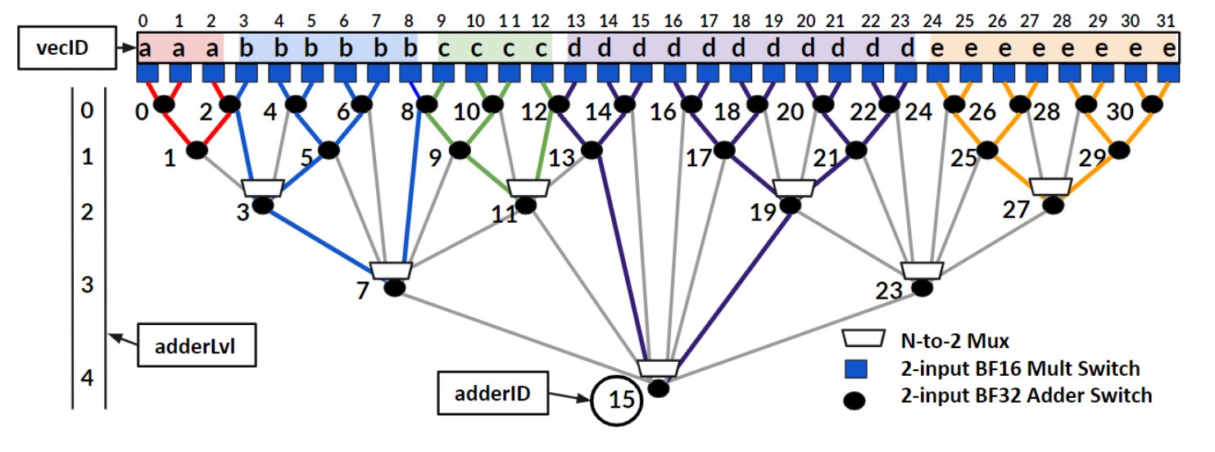
Forwarding Adder Network (FAN) Design

Slide 6
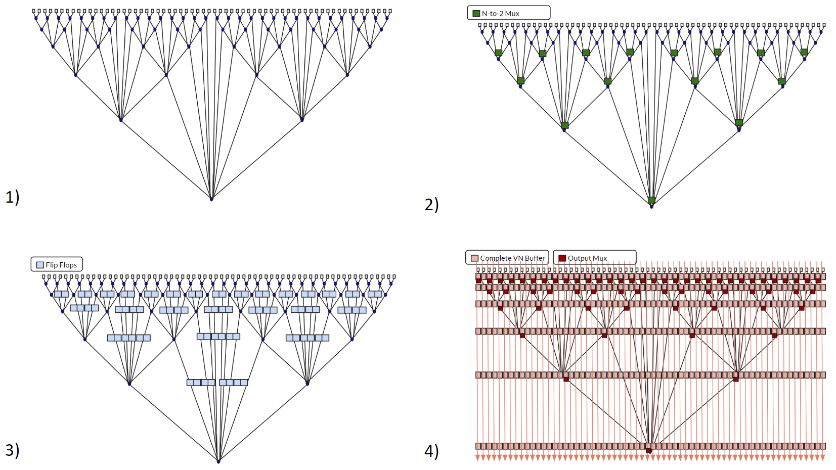
FAN Topology - Pipelining and Components
Standard Interconnect (64 PE wide)
Adding the N-to-2 Mux for selection
Flop Forwarding Links across levels
Put Completed VN onto Output Buffer (Pipeline)

Slide 7
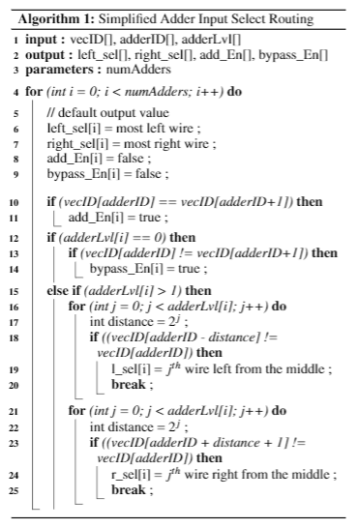
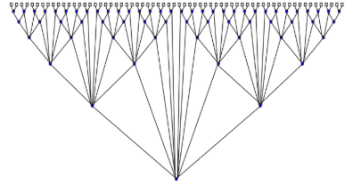
FAN Controller (Need to generate SEL and CMD bits)
Simplified Mux Select Logic (SEL bits)
Adder Functionality (CMD bits)
FAN Controller Integration
CMD Bits | Functionality
000 | nothing
001 | Bypass
010 | RSVD
011 | Send left input as VN output (psum done) and forward right input
100 | Send right input as VN output (psum done) and forward left input
101 | Send both inputs as VN outputs (both psums done)
110 | RSVD
111 | RSVD
i_vn_seperator
multiplier outputs
FAN CTRL
cmd and sel bits
FIFOs
reduction outputs
Note adder bit is enable when vecID[adderID] == vecID[adderID+1]

Slide 8
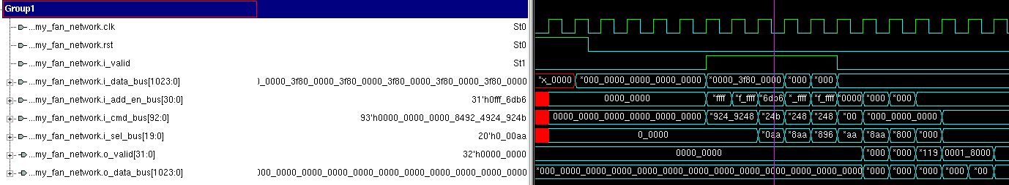
FAN Topology and Controller
Simulation Notes: (32 PEs, BFP16 Multiply, FP32 Accumulation)
my_fan_network.i_valid → valid bit coming in from the multipliers
my_fan_network.i_data_bus[1023:0] → input data coming from the multipliers
my_fan_network.i_add_en_bus[30:0] → flopped add enable bus for each adder
my_fan_network.i_cmd_bus[92:0] → flopped cmd bus for each adder
Determines whether a VN is completed or not and mux into output pipeline buffers
my_fan_network.i_sel_bus[19:0] → flopped select bit for each adder from level 2 onwards
Number of bits required is 2*log(adder_lvl) for each adder from level 2 onwards
my_fan_network.o_valid[31:0] → output valid
32 wide due to potential of having 32 VNs (no reduction needed)
my_fan_network.o_data_bus[1023:0] → output data bus (with all of the final partial sums)

Slide 9
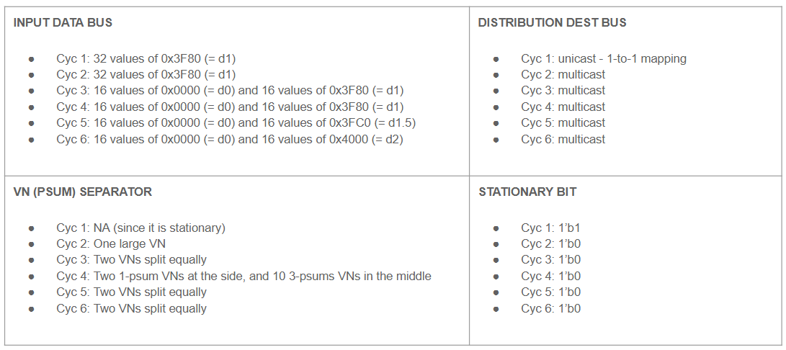
Expected Outcome
Recall the inputs:
Outputs:
Output 1:
None
Output 2:
One 0x4200 (=d32)
Output 3:
Two 0x4180 (=d16)
Output 4:
Two 0x3F80 (=d1)
Ten 0x4040 (=d3)
Output 5:
Two 0x41C0 (=d24)
Output 6:
Two 0x4200 (=d32)

Slide 10

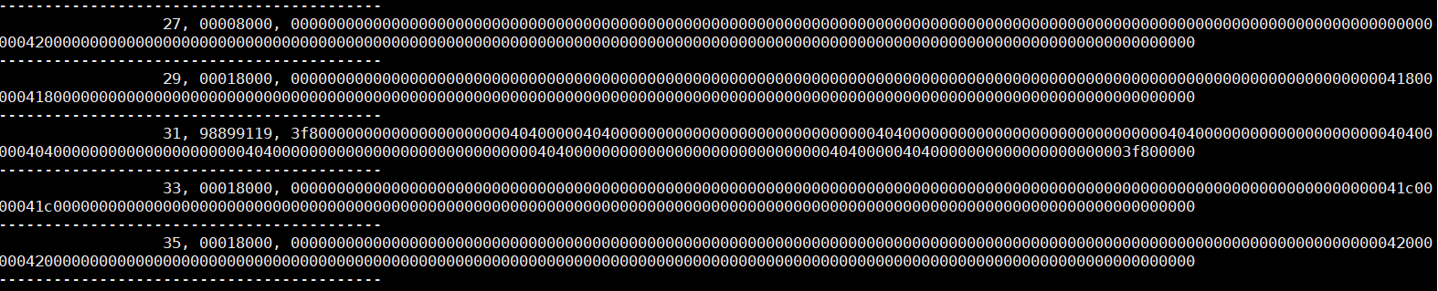
Output Trace Dump Confirming Output

Slide 11
Concerns about current design / Future Work
BFP16 Multiplier and FP32 Adder need verification
Benes Network routing needs to be implemented
Need more functional test cases
Partially unfilled vector needs valid logic
FAN Controller can be optimized (1 bit separator rather than LOG2 bits)
Synthesis of updated design
Rewrite some parts (code hard to follow along)

